Slide 1
MACHINE LEARNING USING PYTHON

Slide 2
Index
Introduction
History in brief
Relationship between AI ML and Deep Learning
Levels in AI
Types of ML algorithms
Some applications in real world
Future with ML
How to build a career in ML/AI

Slide 3
Key Terms
Dataset
A data set is a simple collection of data / information usually in some feasible storage format.
Structured Data
Structured data is the data that has predeﬁned structures.
Example: tables, spreadsheets, or relational databases.
Unstructured Data
Data with no predeﬁned structure, comes in any size or form, cannot be easily stored in tables.
Example: blobs of text, images, audio

Slide 4
Key Terms
Categorical Data
Data that can be labelled or divided into groups.
Example: hair colour
Data Formats
Data format is the format in which the data is stored.
Most Common Data Formats CSV, XML, SQL, JSON, Protocol Buﬀers.
Data Sources
We can find the required data for training through various ways.
Examples: Companies/Proprietary Data, APIs, Government, Academic, Web Scraping/Crawling

Slide 5
Key Terms
Training Data
Training data is the data used to ﬁt your models or the set used for learning
Validation data
Validation data is the data used to tune the parameters of a model
Test data
Test data is the data used to evaluate how good your model is. Ideally your model should never touch this data until ﬁnal testing/evaluation

Slide 6
Key Terms
Big Data
Massive datasets, or data that contains greater variety arriving in increasing volumes and with ever-higher velocity. Cannot ﬁt in the memory of a single machine
Algorithm
Algorithm in machine learning refers to a procedure or formula for solving a problem, based on conducting a sequence of specified actions
Model
Model in machine learning also called as machine learning model is a machine learning algorithm which has been implement though any one of the coding methodologies.

Slide 7
History of Machine Learning
Arthur Samuel, an American pioneer in the field of computer gaming and artificial intelligence, coined the term "Machine Learning" in 1959 while at IBM. As a scientific endeavour, machine learning grew out of the quest for artificial intelligence.
Machine learning, reorganized as a separate field, started to flourish in the 1990s. The field changed its goal from achieving artificial intelligence to tackling solvable problems of a practical nature.

Slide 8
Relationship between
AI, ML and Deep Learning
AI
ML
Deep Learning

Slide 9
What is Artificial Intelligence?

Slide 10
Artificial Intelligence
Computer science defines AI research as the study of "intelligent agents": any device that perceives its environment and takes actions that maximize its chance of successfully achieving its goals.
Generally, the term "artificial intelligence" is used to describe machines that mimic "cognitive" functions that humans associate with other human minds, such as "learning" and "problem solving".

Slide 11
Levels in Artificial Intelligence?

Slide 12
Levels of Artificial Intelligence:
ANI

Slide 13
Levels of Artificial Intelligence:
ANI
AGI

Slide 14
Levels of Artificial Intelligence:
ANI
AGI
ASI

Slide 15
What is Machine Learning?

Slide 16
Machine Learning
Machine Learning is a subset of artificial intelligence which focuses mainly on the learning from their experience and making predictions based on its experience.
It enables the computers or the machines to make data-driven decisions rather than being explicitly programmed for carrying out a certain task. These programs or algorithms are designed in a way that they learn and improve over time when are exposed to new data.

Slide 17
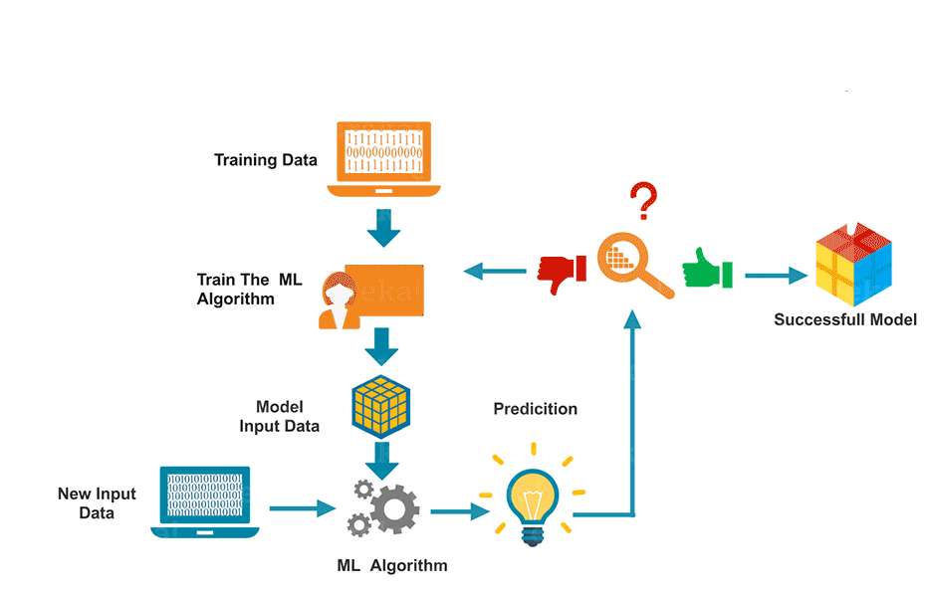
Machine Learning

Slide 18
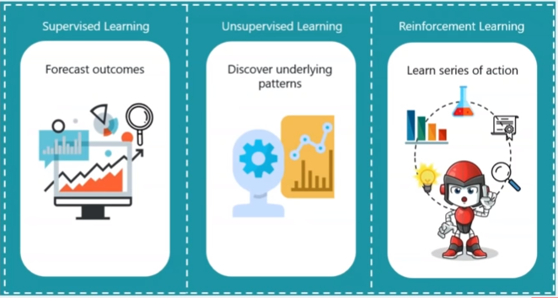
Machine Learning AIM:

Slide 19
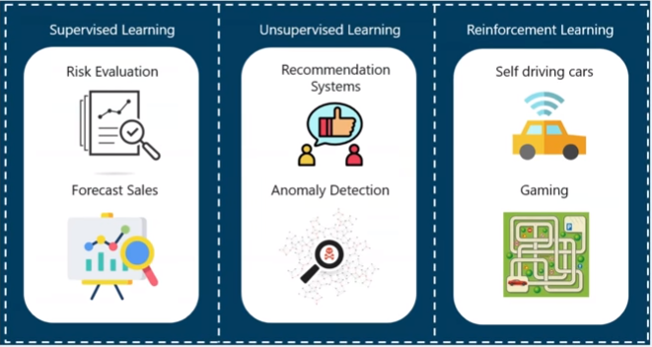
Machine Learning Applications:

Slide 20
Types of Machine Learning Algorithms

Slide 21
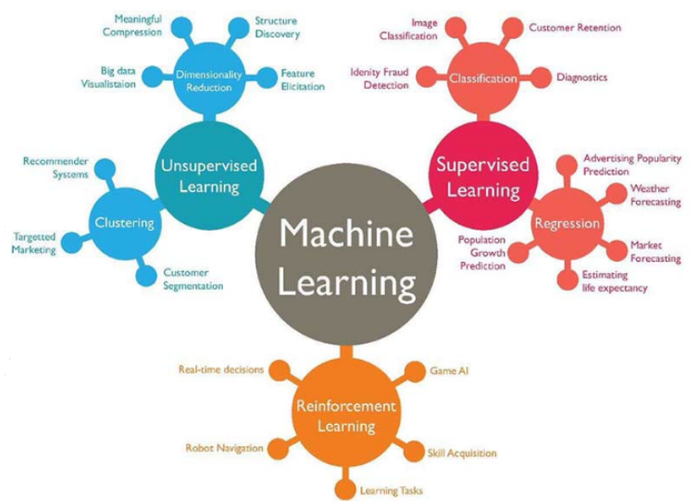
Types of Machine Learning Algorithms

Slide 22
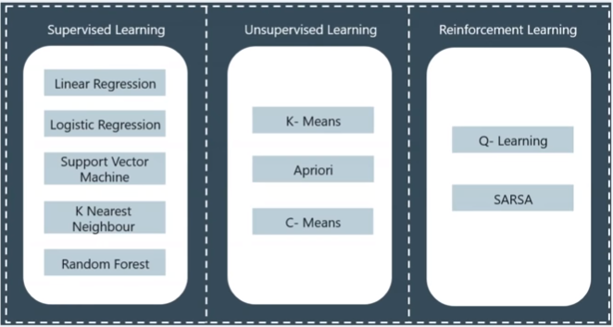
Machine Learning Algorithms:

Slide 23
What is Deep Learning?

Slide 24
Deep Learning
Deep learning (also known as deep structured learning or hierarchical learning) is part of a broader family of machine learning methods based on artificial neural networks. Learning can be supervised, semi-supervised or unsupervised.
Deep learning architectures such as deep neural networks, deep belief networks, recurrent neural networks and convolutional neural networks have been applied to fields including computer vision, speech recognition, natural language processing, audio recognition, social network filtering, machine translation etc, where they have produced results comparable to and in some cases superior to human experts.

Slide 25
Traditional Computing vs Machine Learning Systems

Slide 26
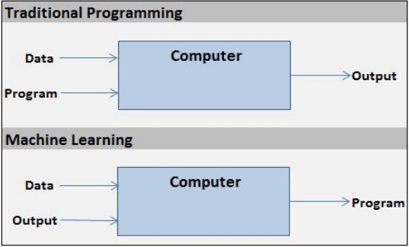
Traditional Computing vs Machine Learning System

Slide 27
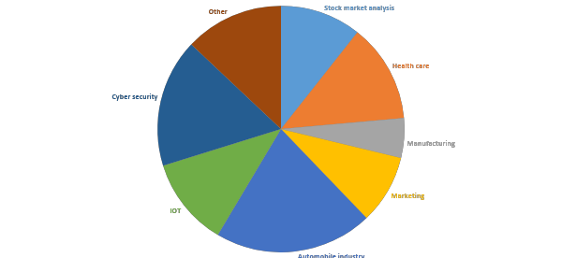
Use of AI/ML in today’s world

Slide 28
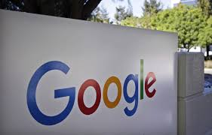
Use of AI/ML in today’s world
Google

Slide 29
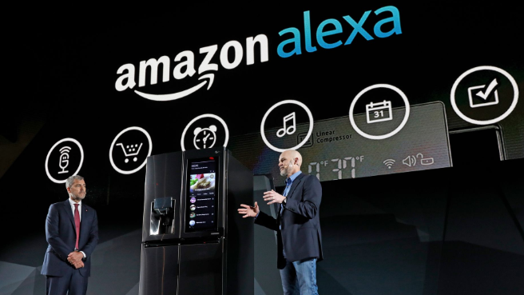
Use of AI/ML in today’s world
Google
Amazon

Slide 30

Use of AI/ML in today’s world
Google
Amazon
Facebook

Slide 31
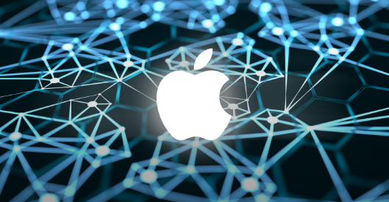
Use of AI/ML in today’s world
Google
Amazon
Facebook
Apple

Slide 32
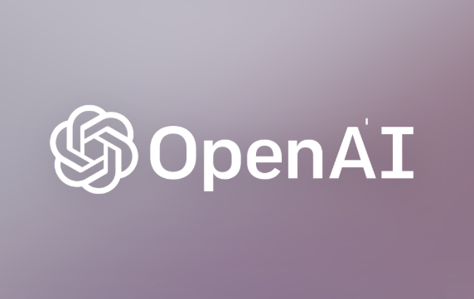
Use of AI/ML in today’s world
Google
Amazon
Facebook
Apple
Open AI

Slide 33

Use of AI/ML in today’s world
Google
Amazon
Facebook
Apple
Open AI
IBM

Slide 34
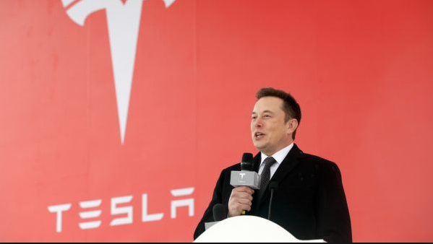
Use of AI/ML in today’s world
Google
Amazon
Facebook
Apple
Open AI
IBM
Tesla

Slide 35

Use of AI/ML in today’s world
Google
Amazon
Facebook
Apple
Open AI
IBM
Tesla
Hanson Robotics

Slide 36
Future with AI/ML
Self driving cars
Improved medical care
Help in various research teams
Military services
Bomb squad replacement
Space exploration
etc

Slide 37
How to build a career in AI/ML ?
Choose a language of your comfort
Learn some basics of AI/ML through any online course
Join a community or form one
Compete on Kaggle making projects
Apply for internships/jobs

